Slide 1


Marwadi Education Foundation’s Group of Institutions Faculty of Computer Applications MCA Sem- III
Fundamental of Java Programming
(630002)
Unit – 2
Visibility Control

Slide 2
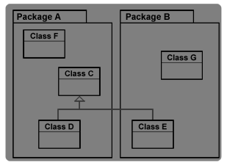
Visibility Control
Public:
When a member of a class is modified by the public specifier then that member can be accesed by any other code in your program.

Slide 3
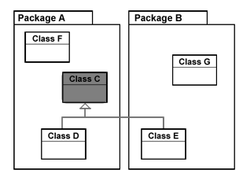
Visibility Control
private
When a member of a class is specified as private then that member can only be accessed by other members of its class.

Slide 4
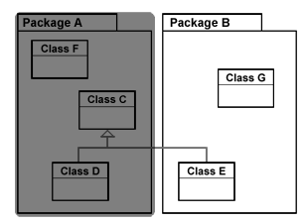
Visibility Control
Default access specifier
When no access specifier is used then by default the member of a class is public within it's own package but cannot be accessed outside of its package.

Slide 5
Visibility Control
Protected:
When a member of a class is specified as protected it is available to all classes in the same package and also available to all subclasses of the class that owns the protected feature.
This access is provided even to subclasses that reside in a different package from the class that owns the protected feature.

Slide 6
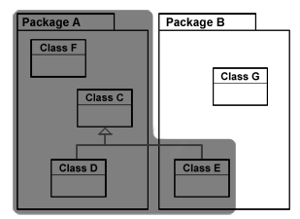
Visibility Control

Slide 7
Visibility Control
private protected:
When a member of a class is specified as private protected it is available to all subclasses of the class in the same package and to the subclasses of the other packages.

Slide 8
Thank You

